Slide 1
Project Design
Stone Stoned: D.A. Toapanta S2074036

Slide 2
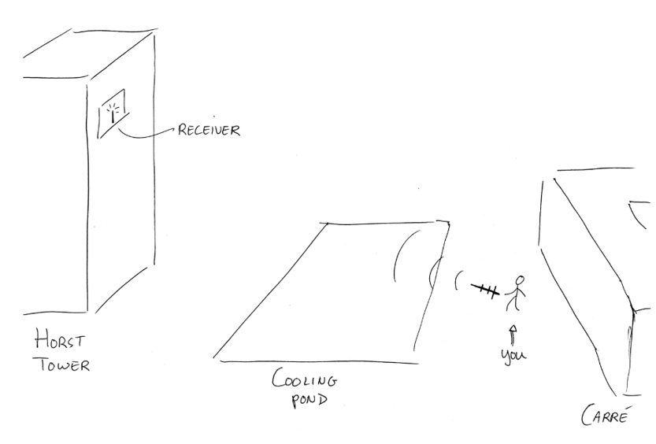
Requirements: - UHF: 433 MHz - Connected to transmitter 50Ω - High directivity
TRANSMITTING ANTENNA

Slide 3
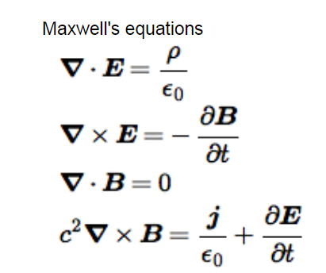
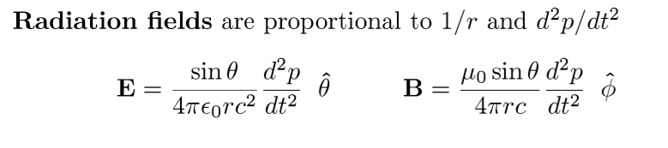
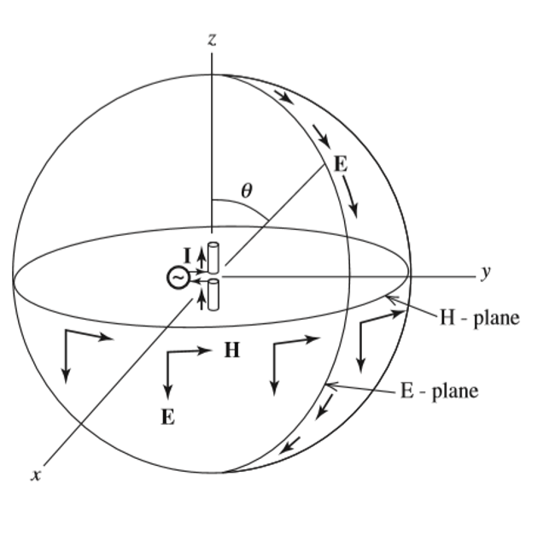
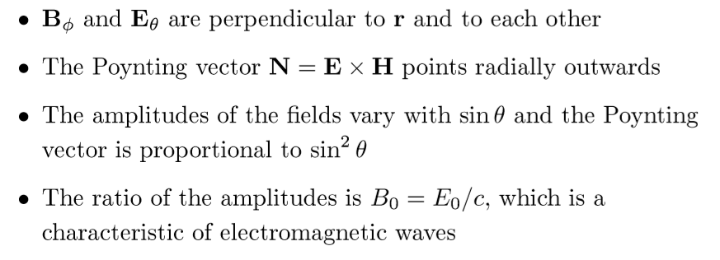
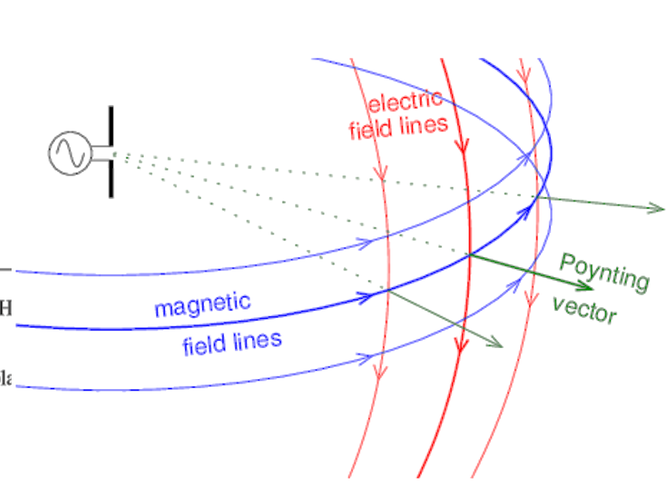
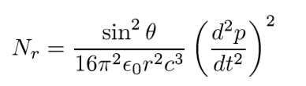
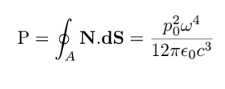
THEORY – EM WAVES
[0]

Slide 4
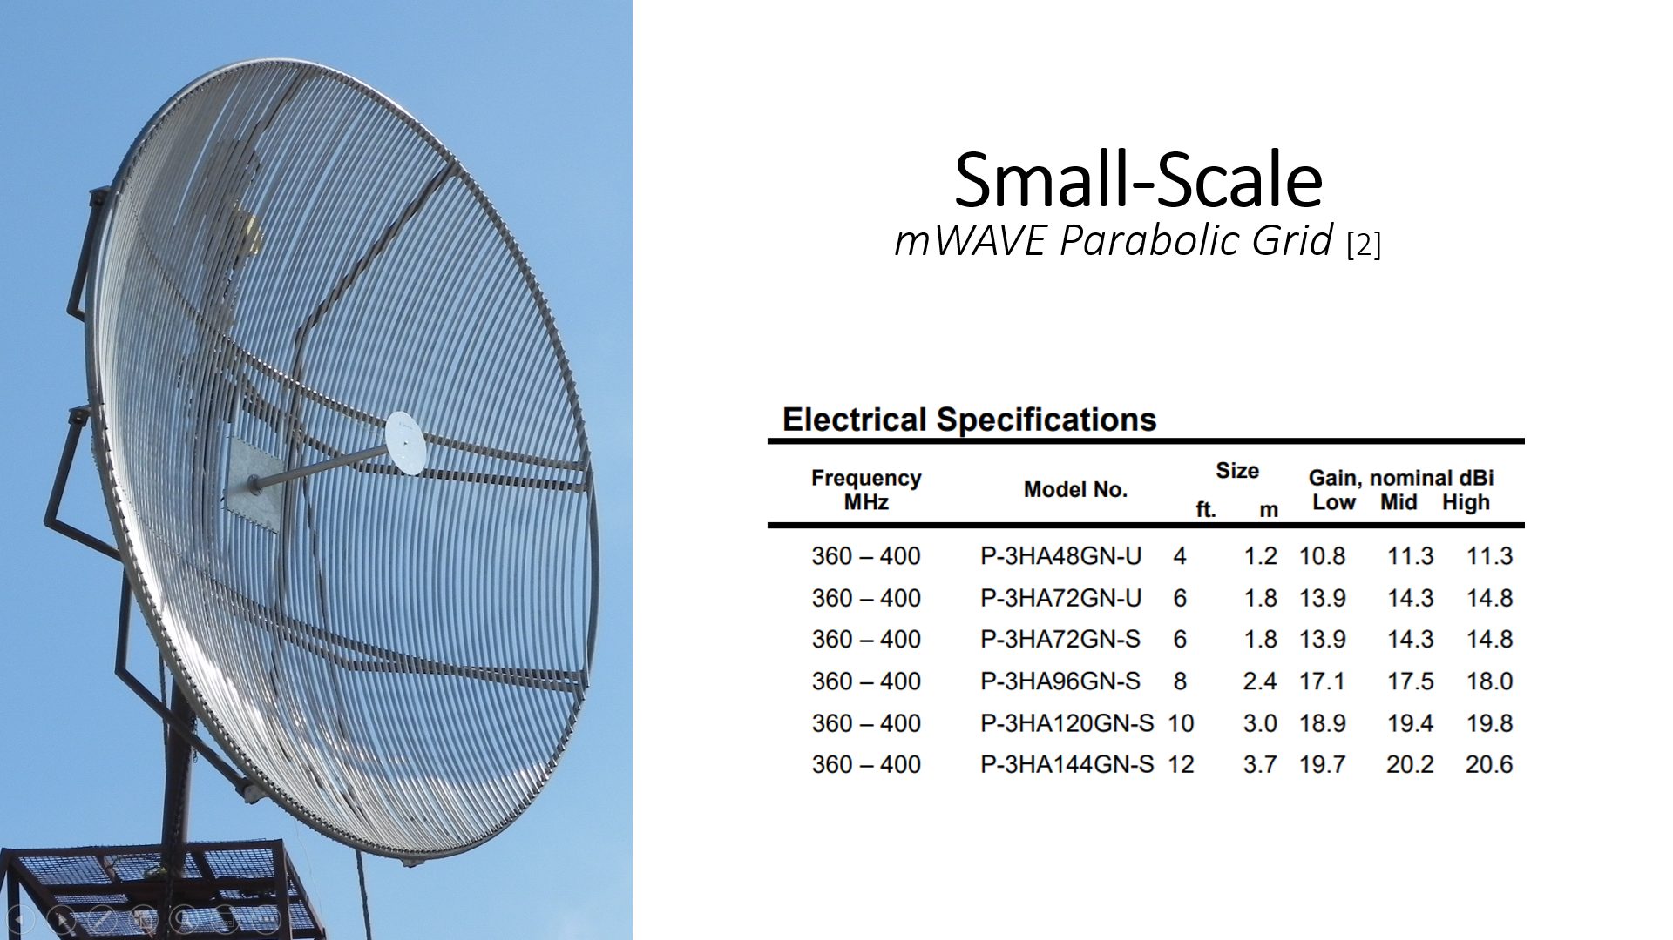
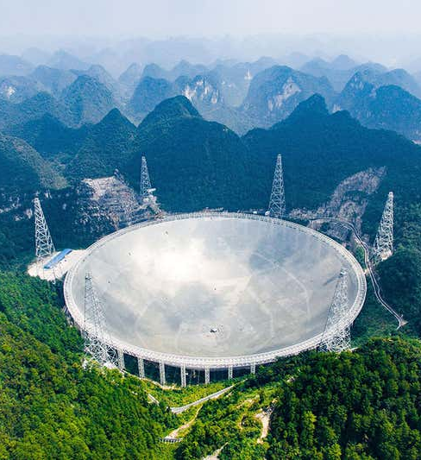
Big-Scale FAST [1]
Gain: 50-70dB
Dimensions: 500 x 300m. (D x W)
Frequency: 70 MHz to 3.0 GHz
China’s Five-hundred-metre Aperture Spherical Telescope

Slide 5
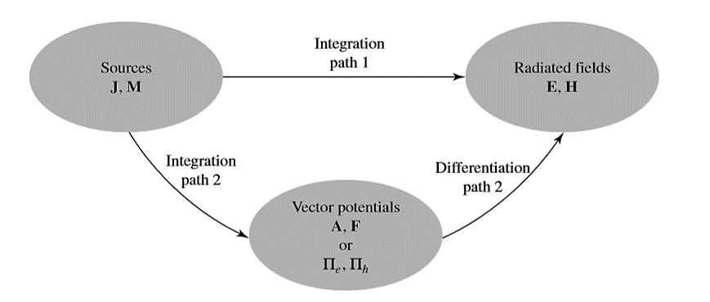
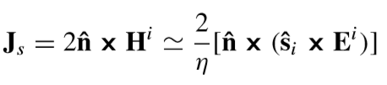
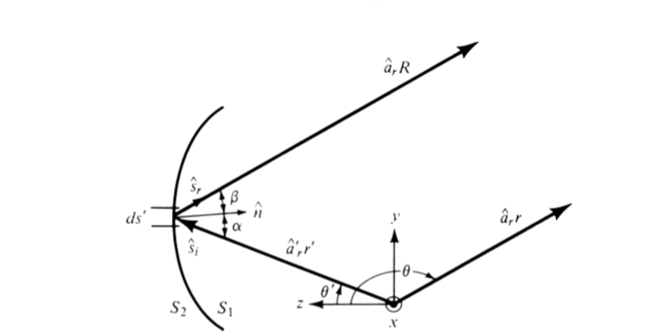
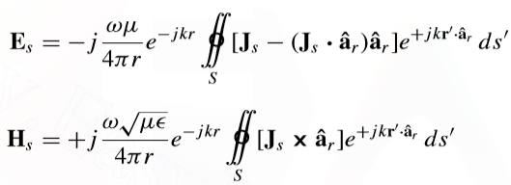
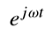
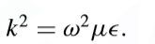


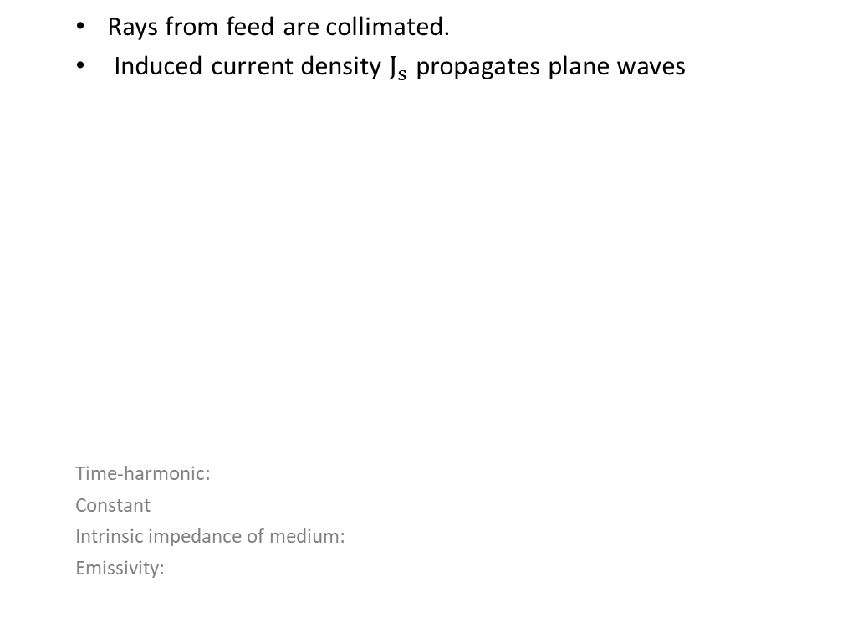
PARABOLIC REFLECTOR FEED WITH DIPOLE ANTENNA [3]
Rays from feed are collimated.
Induced current density $J_{s}$ propagates plane waves
Time-harmonic:
Constant
Intrinsic impedance of medium:
Emissivity:

Slide 6
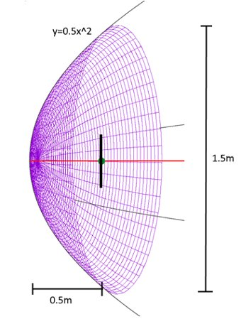
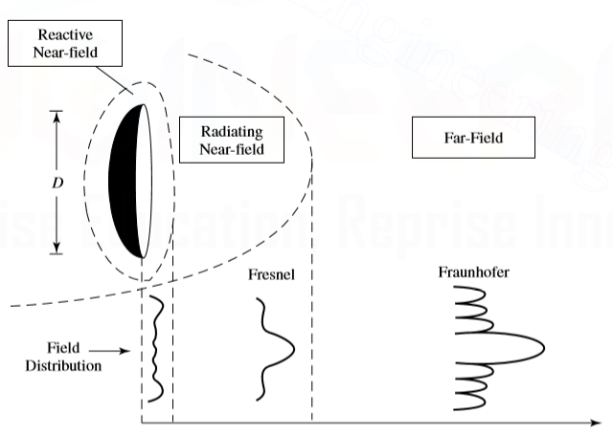
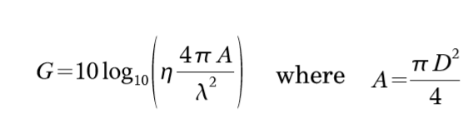
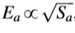
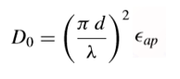
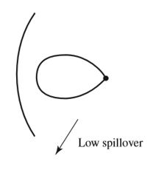
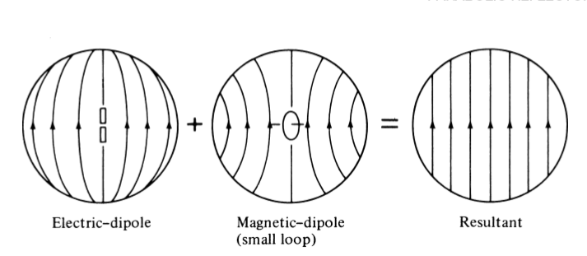
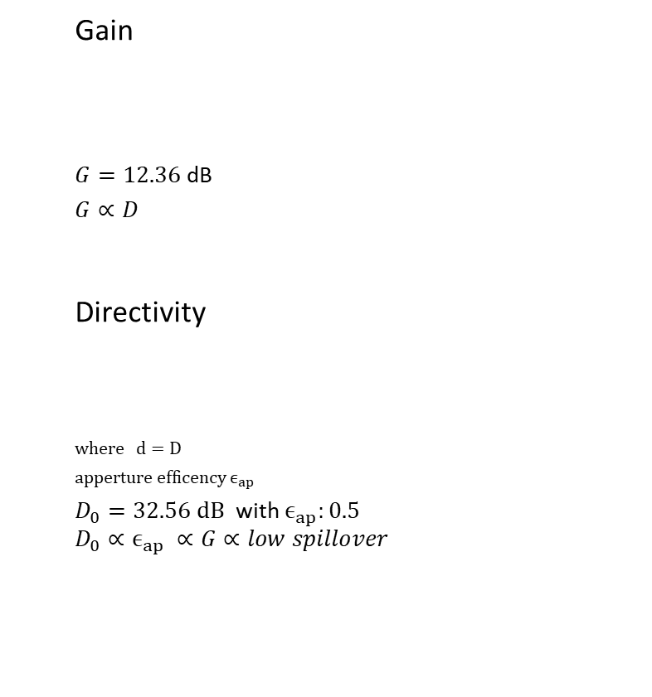
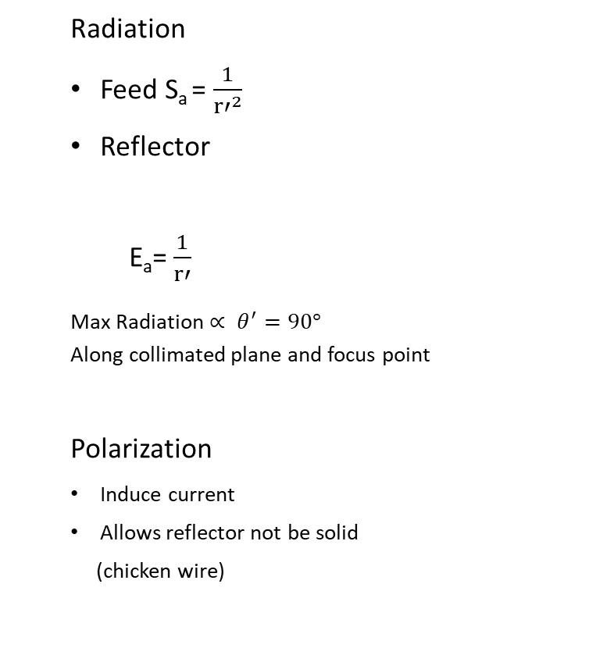
CHARACTERISTICS OF ANTENNA [4]
Gain
$G=12.36$ dB
$$G∝D$$
Directivity
$$where d=D$$
$apperture efficency ϵ_{ap}$
$D_{0}=32.56 dB$ with $ϵ_{ap}:0.5$
$${D_{0}∝ϵ}_{ap} ∝G∝low spillover$$
Radiation
Feed S_{a} = $\frac{1}{{r′}^{2}}$
Reflector
E_{a}= $\frac{1}{r′}$
Max Radiation$∝ θ^{′}=90°$
Along collimated plane and focus point
Polarization
Induce current
Allows reflector not be solid
(chicken wire)

Slide 7
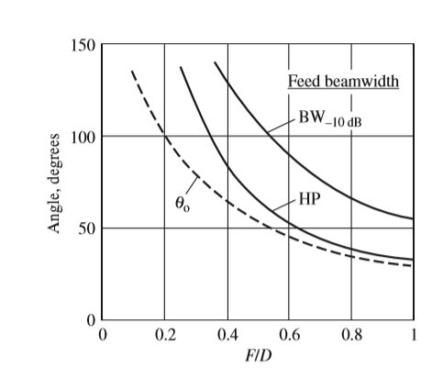
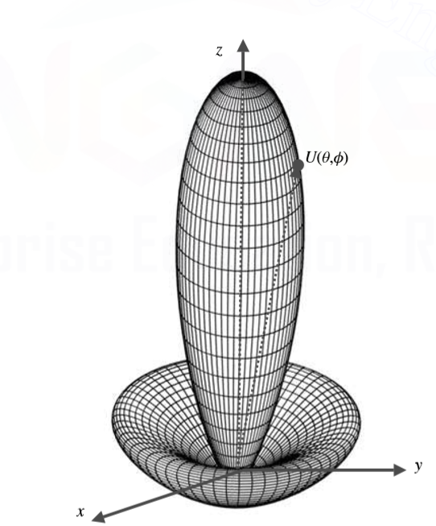

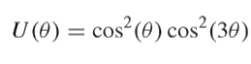
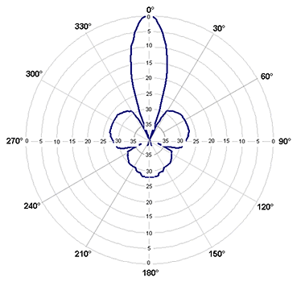
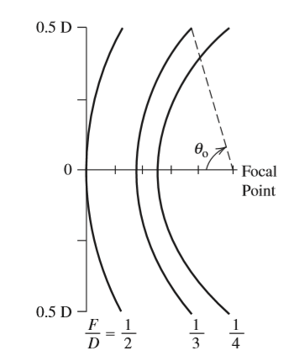
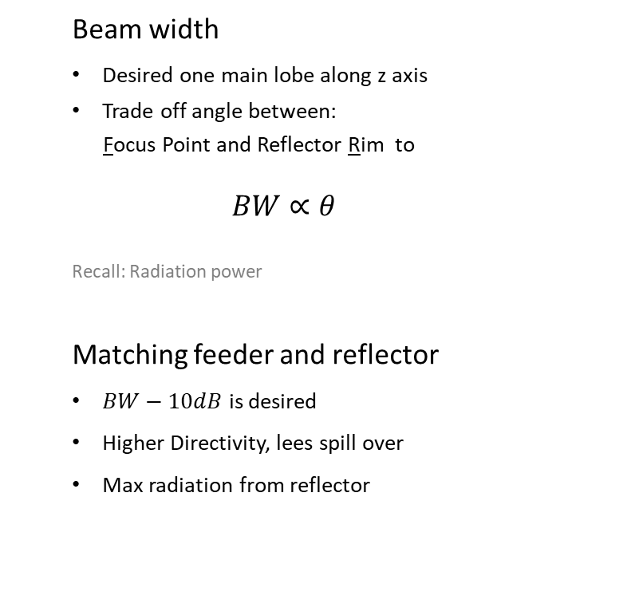
CHARACTERISTICS OF ANTENNA [4]
Beam width
Desired one main lobe along z axis
Trade off angle between:
Focus Point and Reflector Rim to
$$BW∝θ$$
Recall: Radiation power
Matching feeder and reflector
$BW−10dB$ is desired
Higher Directivity, lees spill over
Max radiation from reflector

Slide 8
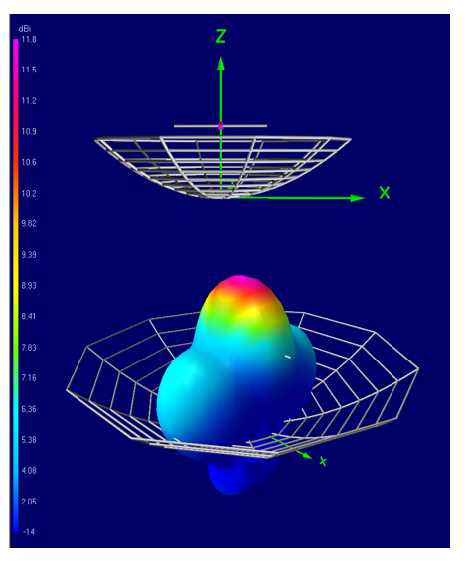
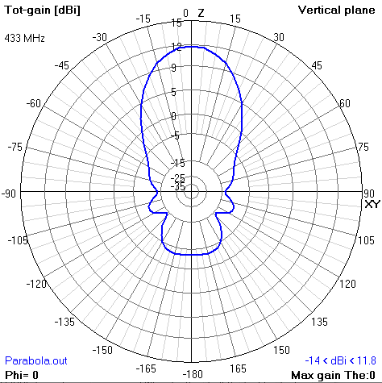
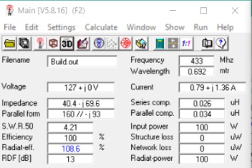
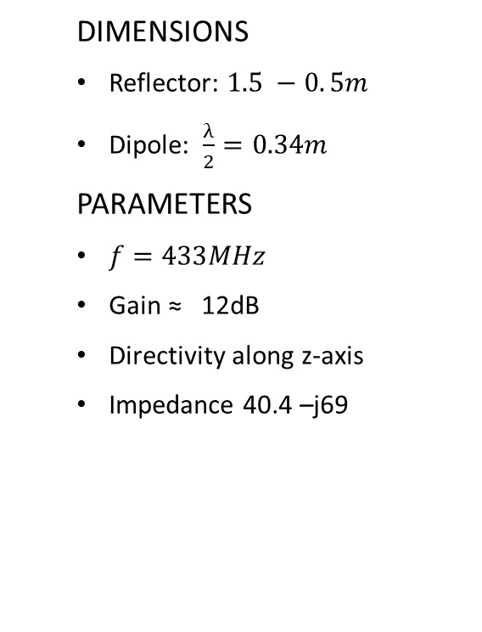
SIMULATIONS [5]
DIMENSIONS
Reflector: $1.5 −0. 5m$
Dipole: $\frac{λ}{2}=0.34m$
PARAMETERS
$f=433MHz$
Gain ≈ 12dB
Directivity along z-axis
Impedance 40.4 –j69

Slide 9
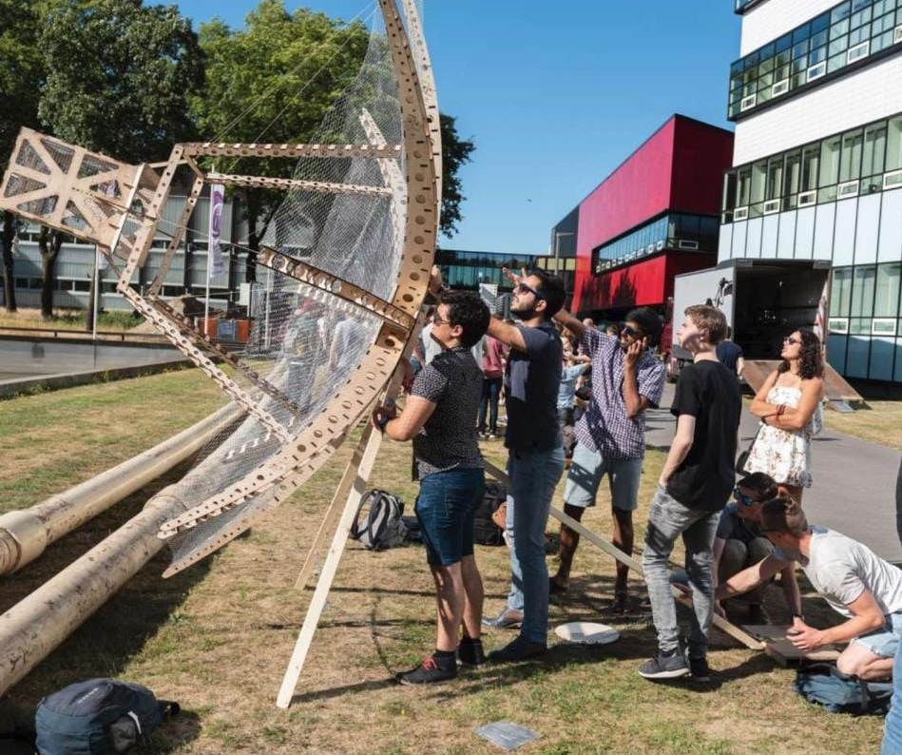
CONSTRUCTION
Construction
Infrastructure
Mouse mesh
Tables
Cooper wire (dipole)
Coaxial cable

Slide 10
WRAPPING UP
Conclusions
Pending issues
Adjust coordinates for focal point
Increase Diameter if possible
Contact near houtzagerij
Solve matching impedance
Reasonable gain
Dipole equations are familiar
Simulations support theory
Nice symmetry on reflector (cylindrical cord.)

Slide 11
Bibliography
[0] Richard Feynman, The Feynman Lectures. Caltech, 2013 http://www.feynmanlectures.caltech.edu/index.html
[1] Last accessed: (15 Jun 2019). Available at: https://en.wikipedia.org/wiki/Five_hundred_meter_Aperture_Spherical_Telescope
[2] Last accessed: (17 Jun 2019) Available at: http://markgridantenna.com/wp-content/uploads/2015/12/360-400-Grid-151015.R1.pdf
[3] Constantine A. Balanis, Antenna Theory: Analysis and Design. Wiley, 2016
[4] Warren L. Stutzman, Gary A. Thiele. Antenna Theory and Design, 3rd Edition, 2012
[5] 4NEC2 program

